Slide 1

Web Development
CCSW321-Project Phase II
Prepared by :
Abrar Ghandurah 1910929
Sama Alehamdi 1915286
Wejdan Almuflihi 1913733
Jona ekram 1915456

Slide 2
Introduction
Our team members have created a gaming website that’s called “Gamer’s Hub” that provides an environment for the people who are passionate about video games and to ensure that they are all having fun while playing

Slide 3
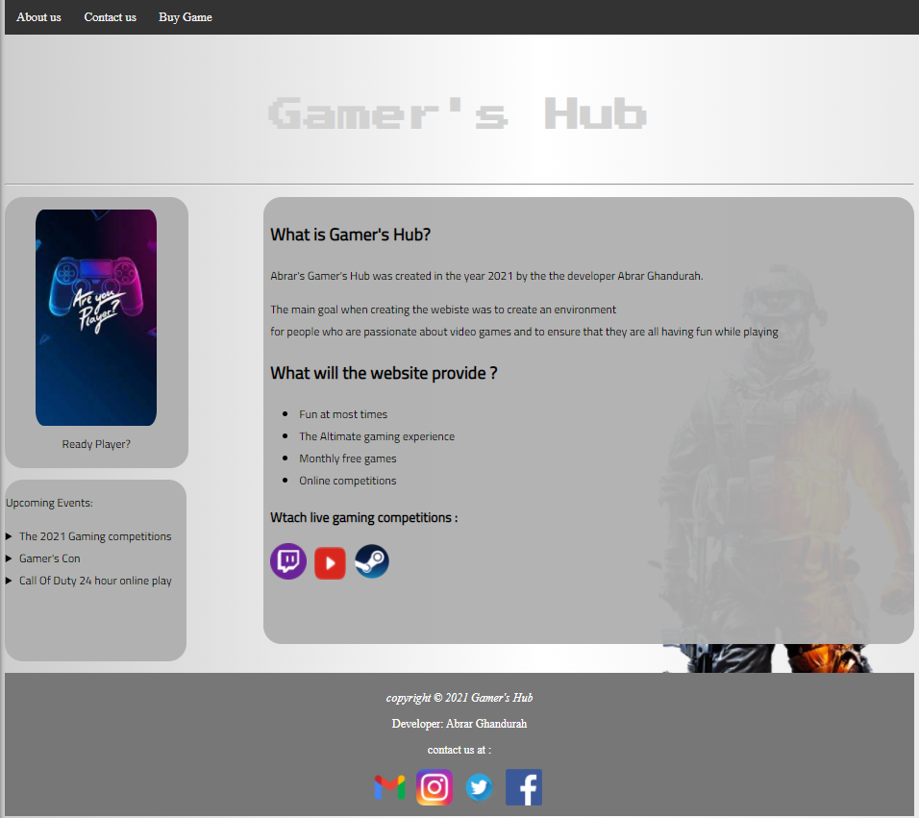
Home Page
In the home page “index.html” we have added :
A brief intro of the website
Links to live gaming sites
Upcoming events
Menu bar to transition between pages
Contact info in the page footer

Slide 4
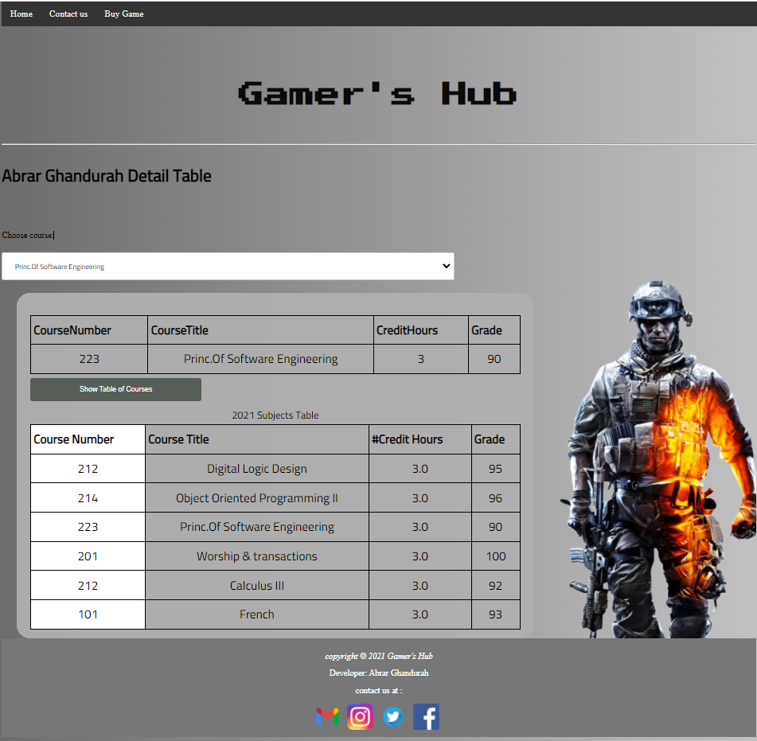
About Us Page
In the about us page “aboutus.html” we have added :
Detail table of subjects using “show table” button
The user can choose a from the drop-down menu a specified subject to appear to the user
Menu bar to transition between pages
Contact info in the page footer
In this page we have also include JavaScript “script.js” :
show/hide info of course from database that we have created
Show/hide course from database when user choose course name from the options
We have linked this page with php page “getCourse.php” to :
To output from database the course detail*
*Note (we have tested the database using our local host using the program XAMP

Slide 5
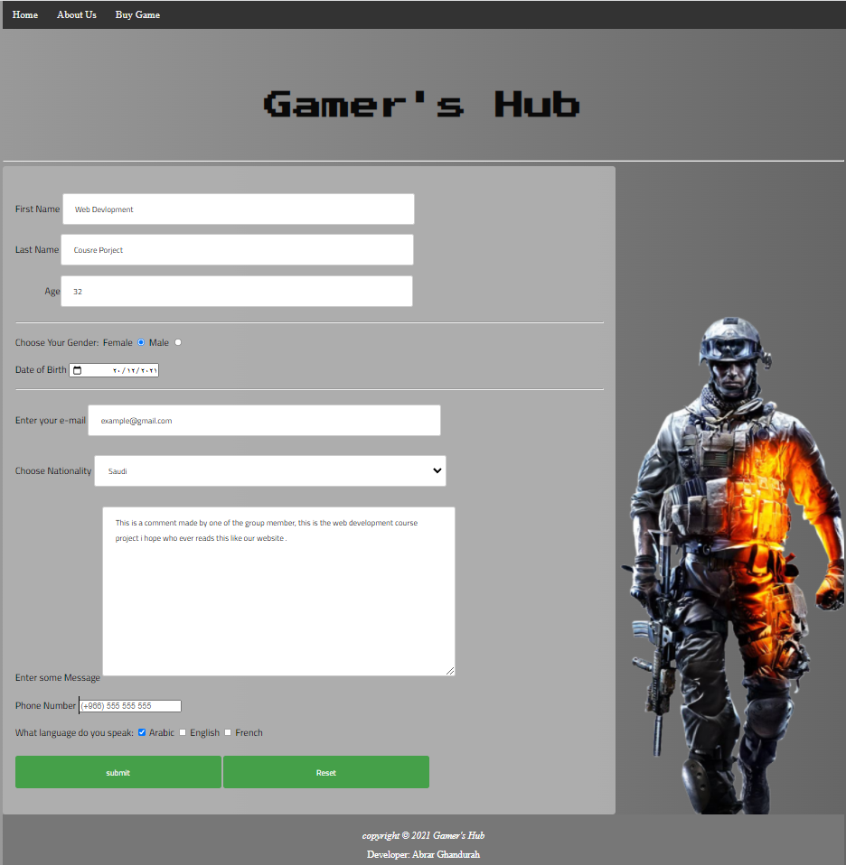
Contact Us Page
In the contact us page “aboutus.html” we have added :
User form to fill out using <form> elements
Menu bar to transition between pages
Contact info in the page footer
In this page we have also include JavaScript :
Validation Form function that validates all the input included :
First & last name
Age
Email format
Gender
Phone number
Note : incase of an error a message will appear to the user
We have linked this page with php page “form.php” to :
Save the form inputs into a database using MySQL*
*Note (we have tested the database using our local host using the program XAMP

Slide 6
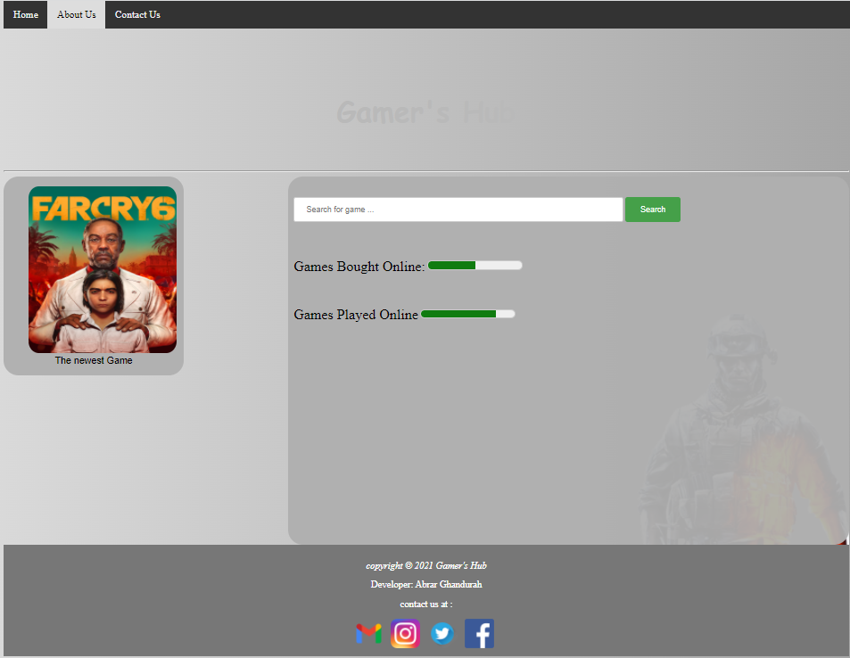
Buy Game Page
In the Buy Game page “page4.html” we have added :
Search bar used to search from an upcoming game
Menu bar to transition between pages
Contact info in the page footer
We have linked this page with php page “search.php” to :
To Output from the database for the game searched:
If found “recordFound.html”
If not found “searchOuput.html”

Slide 7
Thank you For Your Time

